Slide 1
Continuous Delivery
Presented by Tanya Singhal

Slide 2
Agenda
  The Problem of Delivering Software
  A Deployment Pipeline
  Problems in deploying software manually
  How to Achieve Goal of continuous delivery
  Principles of Software Delivery
  Continuous integration
  Why Testing Strategy is necessary?
  What is Deployment Pipeline
  Preparing To Release
Practices of build and Deployment Scripting
Project Structure for Applications That Target the JVM
Deployment Scripting

Slide 3
The Problem of Delivering Software
The most important problem that we face as software professionals is this: If somebody thinks of a good idea, how do we deliver it to users as quickly as possible?
The pattern that is central to this book is the deployment pipeline.

Slide 4
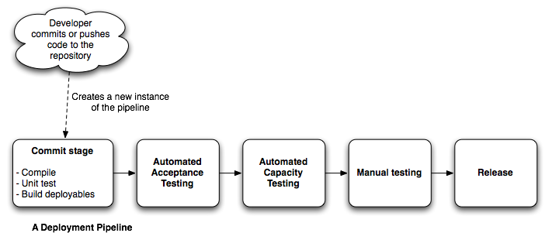
A Deployment Pipeline
Also known as Continuous Integration Pipeline, build pipeline, etc.
Describes your process of getting software from version control into the hands of users.

Slide 5
Problems in deploying software manually
Error will occur every time
Not repeatable or reliable
Time consuming and expensive
Needs lots of documentation with steps
That are misinterpreted, and untested in a production-like environment

Slide 6
Problems in deploying software manually Continue …
Many corrections during a release
Manual testing to confirm deployment
Releases take hours instead of minute
Frequent roll-backs Late nights

Slide 7
Solution
Integrate testing, deployment and release activity into development.
Automate deployments as much as possible
Scripts equal up-to-date documentation, encourage cooperation and sharing
Automation makes processes repeatable, testable, less boring and fast

Slide 8
AP: Deploying to a Prod-like Environment after Dev Is Complete
Testers have only tested in a Dev environment
Prod team have never done deployment before
All kinds of infrastructure-related problems pop up after the development was done
Lots of arguments between Ops & Dev

Slide 9
Solution
Start deploying to a prod-like environment as soon as you start developing
Integrate testing, deployment and release into a standard part of your dev process
If you already have good Continuous Integration, this means: add deployment/release to it (correctly)

Slide 10
AP: Manual Configuration Management of Prod Environments
Configuration of an environment is a lot
Deployments to prod fails after successful deployments to other environments
Differences between nodes in production
Cannot roll back your environment
Different versions of packages
Basically: No overview, no control

Slide 11
Solution
Set up your entire environment using an automated process that is stored in version control
Specifically any and all configuration - of your OS, of OS tools and middleware, and of your application
Your prod environment is key - it must be reproducible in your staging and dev environments

Slide 12
How to Achieve Goal of continuous delivery
Automated
Frequent Releases
Feedback

Slide 13
Principles of Software Delivery
Create a Repeatable, Reliable Process for Releasing Software
Automate Almost Everything
Keep Everything in Version Control
If It Hurts, Do It More Frequently, and Bring the Pain Forward
Build Quality In
Continuous Improvement

Slide 14
If you have a good configuration management strategy, you should be able to answer “yes” to all of the following questions:
Can I exactly reproduce
    Product environment
    version of the OS
    its patch level
    the network configuration
    the applications deployed into it & their configuration

Slide 15
Continue…
Can I easily make an incremental change in
      Any of the features of product
      And deploy it in all my environment
Can I easily see each change and trace it back
      what the change was
      who made it
      When they made it

Slide 16
Last but not the least,
Information should be easily available to each member
  Frequent check in
  Automatically benefits
    Efficient delivery
    Reduced feedback

Slide 17
Points we just discussed can be achieved by following practice
Using Version Control
Check In Regularly to Trunk
Use Meaningful Commit Messages
Managing Dependencies
    External libraries
    Components
    Software configuration

Slide 18
Why Version Control is Important
Helps to reproduce a particular state of the software’s binaries and configuration
What was done when, by whom
allows you to recover an exact snapshot of the state of the entire system, from dev environment to prod environment, at any point in the project’s history
store binary images of their application servers, compilers, virtual machines

Slide 19
Continuous integration
An extremely strange and serious problem with many software projects is that-
For “long periods of time during the development” process
the application is not in a working state
Problems faced-
  Significant time software is unusable
  Nobody is interested in trying to run the whole application until it is finished
  Software is not compatible at the time of delivery
  Hell lot of problems during build

Slide 20
Prerequisites of continuous integration
Version Control
An Automated Build
Agreement of team
Create a Comprehensive Automated Test Suite
Keep the Build and Test Process Short
Managing Your Development Workspace

Slide 21
Essential Practices In Continuous Integration
Don’t Check In on a Broken Build
Always Be Prepared to Revert to the Previous Revision
Don’t Comment Out Failing Tests
Test-Driven Development
Failing the Build for Slow Tests
Always Run All Commit Tests Locally before Committing, or Get Your CI Server to Do It for You

Slide 22
Why Testing Strategy is necessary?
functional aspects of the system
Increase confidence
reduced support costs
Capacity, security,
and other nonfunctional requirements are established early on, and automated
test suites are written to enforce them.

Slide 23
Types Of Test
Business-Facing Tests That Support the Dev Process
Technology-Facing Tests That Support the Dev Process
Business-Facing Tests That Critique the Project
Technology-Facing Tests That Critique the Project

Slide 24
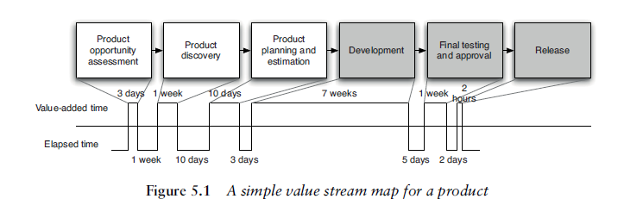
What is Deployment Pipeline
A deployment pipeline is an automated manifestation of your process for getting software from version control into the hands of your users.

Slide 25
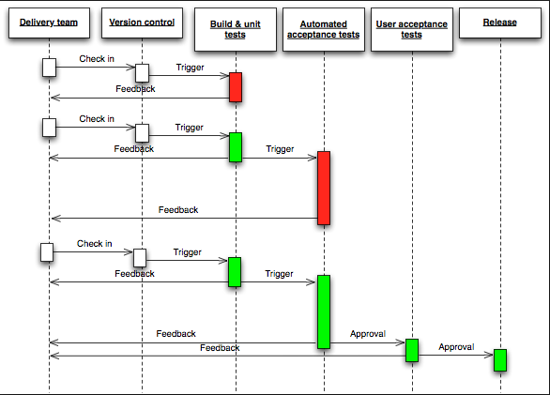
Deployment Pipeline

Slide 26
Deployment Pipeline Practices
Only Build Your Binaries Once
Deploy the Same Way to Every Environment
Smoke-Test Your Deployments
Deploy into a Copy of Production
Each Change Should Propagate through the Pipeline Instantly
If Any Part of the Pipeline Fails, Stop the Line

Slide 27
Preparing To Release
Have a release plan
Minimize the effect of people making mistakes by automating as much of the process as possible
Rehearse the procedure often in prod-like environments
Have the ability to back out a release if things don’t go according to plan
Have a strategy for migrating configuration and prod data as part of the upgrade and rollback processes

Slide 28
Practices of build and Deployment Scripting
Create a Script for Each Stage in Your Deployment Pipeline
Use the Same Scripts to Deploy to Every Environment
Use Your Operating System’s Packaging Tools
Evolve Your Deployment System Incrementally

Slide 29
Project Structure for Applications That Target the JVM
Project Layout
Managing Source Code
Managing Tests
Managing Build Output
Managing Libraries

Slide 30
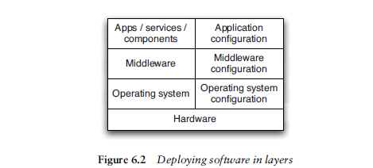
Deployment Scripting
Deploying and Testing Layers

Slide 31
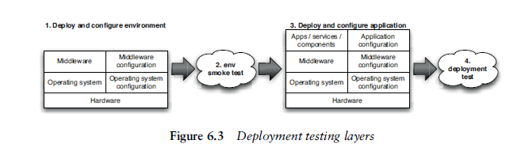
Deployment Testing Layers
Testing Your Environment’s Configuration

Slide 32

Any Questions?

Slide 33
Thank You!

